Slide 1
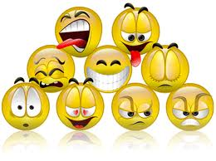
MOOD BOARDS

Slide 2
Mood Boards
Mood boards are commonly referred to as “theme boards”.
The purpose of these exercises are to find unique inspiration for the design of your project from a chosen theme.

Slide 3
Instructions
Step 1: Choose a theme or a mood! This can be anything. It doesn’t have to relate directly to your project or keyword, the goal is to spark off inspiration for your design.
Step 2: splash out images related to this theme. On a page by using the internet (easier) or by using cuttings from a magazine.
Step 3: Scan over the board and select one or several images to draw on inspiration for your design.

Slide 4
Remember!
It is important not to think hard about the images you are putting in, but they must incorporate the chosen theme.
Lets see a few examples!

Slide 5



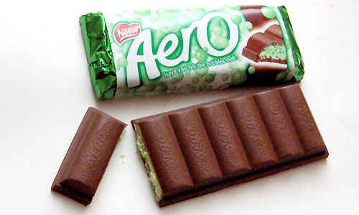
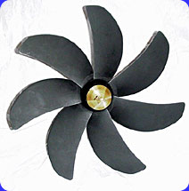

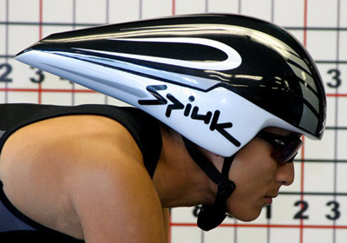

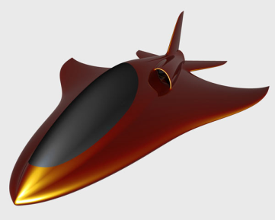



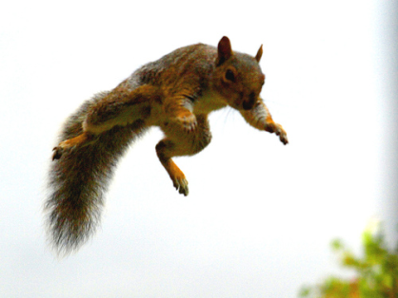
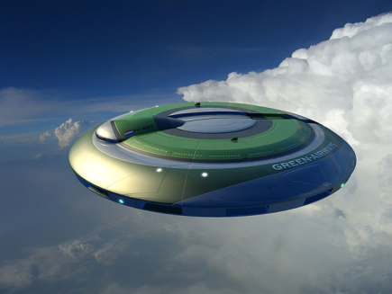

Aerodynamics

Slide 6
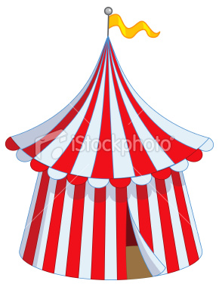
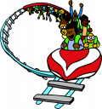
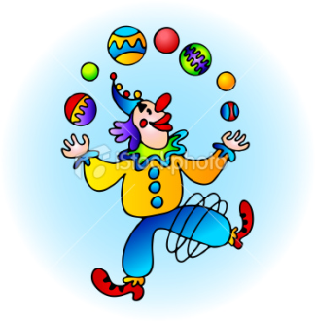
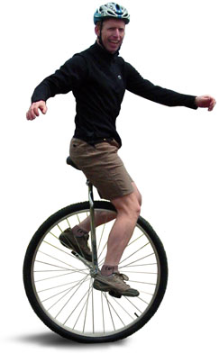
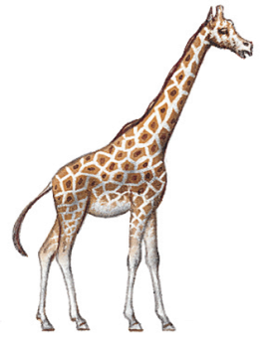




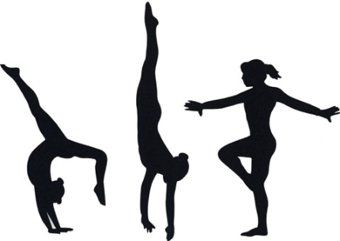


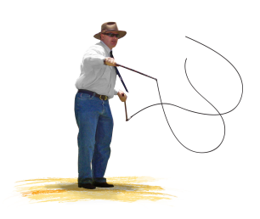
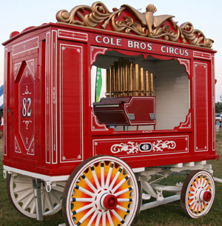


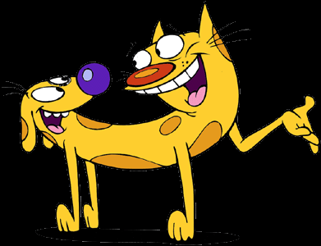
The Circus

Slide 7
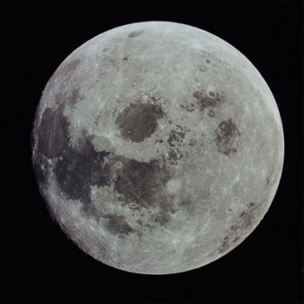



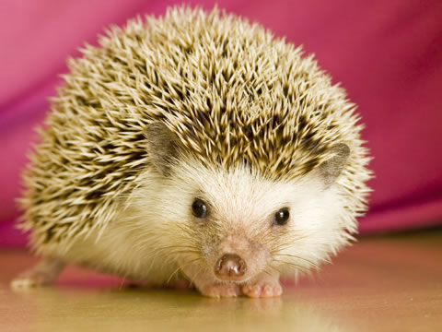
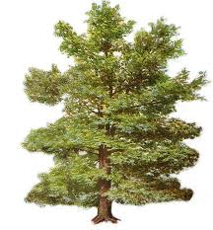

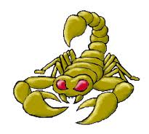



Nature

Slide 8
Activities
Use the keyword “Green” for your theme board and sketch what innovative products/designs you may find.
Use the keyword “Technology” for your theme board and sketch what innovative products/designs you may find.
Use the keyword “Beauty/fashion” for your theme board and sketch what innovative products/designs you may find.
Use the keywords “Off road vehicle” for your theme board and sketch what innovative products/designs you may find.
Use the keywords “Educational toys” for your theme board and sketch what innovative products/designs you may find.

